Slide 1

DAVAO DOCTORS COLLEGE
“Dedication, Drive & Competence”
41st COMMENCEMENT EXERCISES
RAUL C. ALVAREZ, JR. REE, Ed.D, CESO III
Director IV – CHEDRO XI

Slide 2
A CHALLENGE TO THE DDC COMMUNITY
HOW MAY DDC CONTINUOUSLY ATTAIN
EXCELLENCE?
Notes:
In my opinion there is no other way for DMSF move towards gaining competitiveness except through Quality Assurance in as much as it at the core of the MRAs and student and faculty mobility in the ASEAN. QA is expected to ensure that the educational standards of DMSF are benchmarked and harmonized among universities in the region.

Slide 3

Development of person not as a person but as a globally competitive individual
Notes:
THE CALL OF 2015 ASEAN INTEGRATION is the Development of person not as a person but as a globally competitive individual. This connotes the need for our educational system in general, and the medical education system in particular to instill in their graduates a DEGREE OF KNOWLEDGE, SKILLS, AND VALUES at par, if not better, than the other member states. You graduates need to hone yourselves in particular set of skills that will make an INDIVUAL, or distinct from other medical education graduates.

Slide 4
QUALITY & EXCELLENCE =
Compliance to Global Standards / Accreditation
DDC
Instruction, Research & Extension, Innovation
Deans, Faculty & Students
Commitment & Direction
BOT / President
Competent & Competitive Graduates

Slide 5
AS LEVEL 6 & 7 GRADUATES:
KNOWLEDGE, SKILLS AND VALUES - for professional & creative work and lifelong learning
APPLY - research and innovation in the field of discipline
SUBSTANTIAL DEGREE OF INDEPENDENCE

Slide 6
FOR “NEW” PROFESSIONALS:
TOP 3 QUALITIES & SKILLS THAT EMPLOYERS WANT

Slide 7
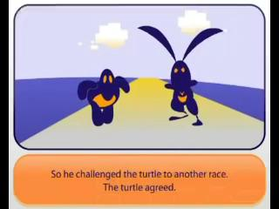
RABBIT VS TURTLE RELOADED

Slide 8
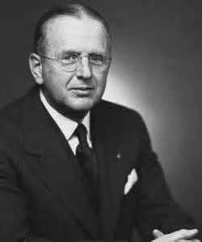
“…habitually look for the best results from the worst conditions”
Norman Vincent Peale (1898 - 1993)
American Writer and Minister

Slide 9
1. Stress Tolerance
Handle any demand and work well under pressure
Maintain peace and harmony in the workplace
Open to change to complete work more efficiently

Slide 10
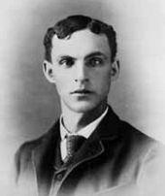
“Chop your own wood, and it will warm you twice.”
Henry Ford (1863-1947);
Founder Of Ford Motor Company

Slide 11
2. Integrity
doing the right thing even when no one is looking, and especially when the choice isn’t easy’ -
    Coming to work on time
    Can be trusted what you say and do.
    Gains the trust of customers and maintain the attitude that “the customer is always right”.

Slide 12
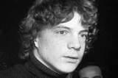
“My Formula for Success: Rise early, work late, strike oil”
J. Paul Getty (1892 - 1976)
American Oil Magnate

Slide 13

“Genius is 1% inspiration and
99%
perspiration”
Thomas A. Edison (1847 - 1931)
American Inventor

Slide 14
3. Strong Work Ethic
willingness to work hard and smart
Learn the most efficient way to complete tasks
Does not waste valuable time attending to personal issues not related to the job.

Slide 15
THREE COMMON CAUSES OF FAILURE
1. LACK OF FOCUS & MIND SET
2. LACK OF CONSISTENCY
3. LACK OF RESILIENCY
THE BOTTOMLINE:
“NEVER MAKE ANY EXCUSE FOR NOT BEING ABLE TO SUCCEED”

Slide 16
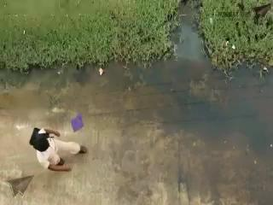
WHICH PERSON ARE YOU?

Slide 17
MY THOUGHTS
THE VIRTUES
YOU NEED
TO “SUCCEED”

Slide 18
DEDICATION to Goals
D
Born into poverty and was faced with defeat all his life.
At 7: His family was forced out of their home. He had to work to support them.
At 9: His mother died.
At 22: He failed in business.
At 23: He ran for state legislature – lost.

Slide 19
At 23: Lost his job and wanted to go to law school but couldn’t get in.
At 24: Borrowed money to begin a business that again got bankrupt. He spent the next 17 years paying the debt.
At 25: Ran for state legislature again – won.
At 26: He was engaged to be married but his sweetheart died

Slide 20
At 27: Had a total nervous breakdown and was in bed for six months.
At 29: Sought to become speaker of the state legislature – defeated.
At 31: Sought to become elector – defeated.
At 34: Ran for Congress – lost

Slide 21
At 37: Ran for Congress again – this time he won and did a good job.
At 39: Ran for re-election to Congress – lost.
At 40: Sought the job of land officer in his home state – rejected.
At 45: Ran for Senator – lost.

Slide 22
At 47: Sought the Vice-Presidential nomination – got less than 100 votes.
At 49: Ran for Senator again – again he lost!
He lost 8 elections, twice failed in business and suffered a nervous breakdown. He could have quit many times – but he didn’t!

Slide 23
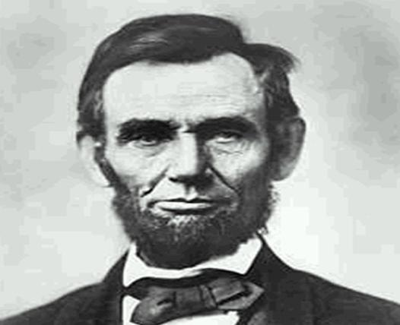
“Always bear in mind that your own resolution to succeed is more important than any other one thing” – Abraham Lincoln
16th American President, elected in 1860

Slide 24
D
DRIVE amidst adversity
A stow away, uneducated and hungry
A mess sergeant of Battery B, 8th Field Artillery
On February 24, 1942, he saw the cannon of another battery cold, run 1000yards to put back the cannon in action, ALONE FOR TWO DAYS
Stopped the advance of enemy soldiers

Slide 25
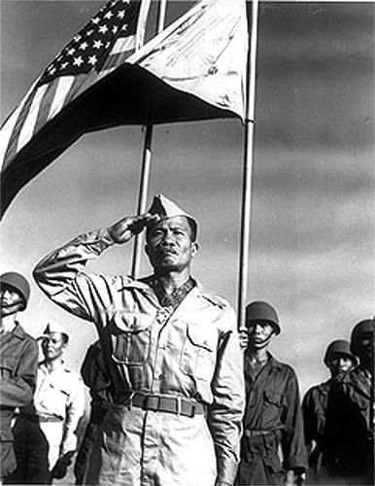
Sergeant Jose Calugas, a Philippine Scout, was the second to receive the US Congressional Medal of Honor and the first enlisted man and the ONLY FILIPINO to be so honored.

Slide 26
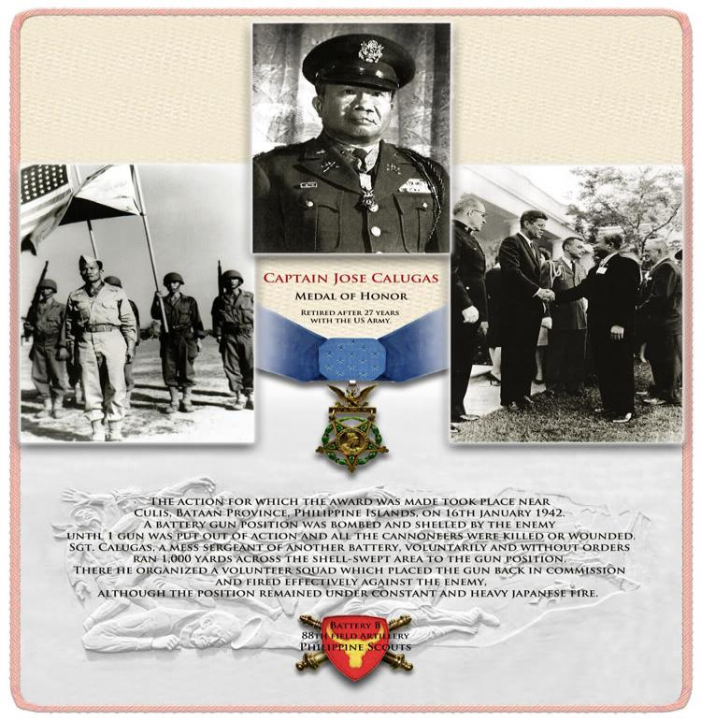
The Medal of Honor is the highest award for valor in action against an enemy force which can be bestowed upon an individual serving in the Armed Services of the United States

Slide 27
c
PROFESSIONAL COMPETENCE
KNOWLEDGE
SKILL
PERFORMANCE
ATTITUDE

Slide 28

c
COMPETENCE WITH COMPASSION

Slide 29
CLASS OF 2018
AS GRADUATES
AND AS WOULD-BE PROFESSIONALS
I CHARGE YOU WITH THESE

Slide 30
TAKE CARE OF OUR ENVIRONMENT
1
Garbage Crisis
Water Crisis
Air Pollution Crisis
Food Crisis
Deforestation/Soil Erosion
Marine Degradation

Slide 31
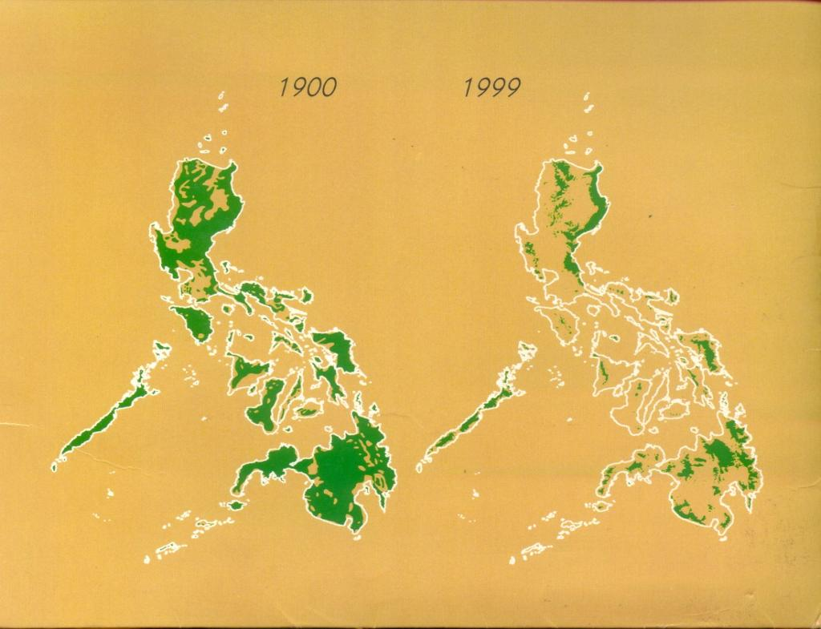
Extent of Philippine Forest Cover Loss in the last 100 years
Source: Environmental Science for Social Change, 1999

Slide 32

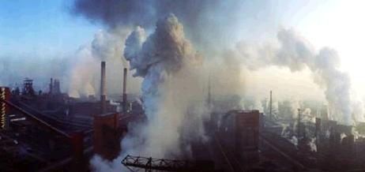
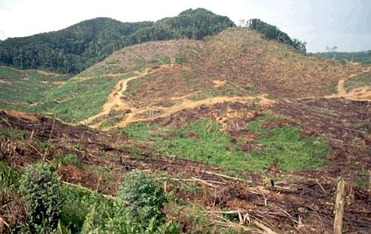
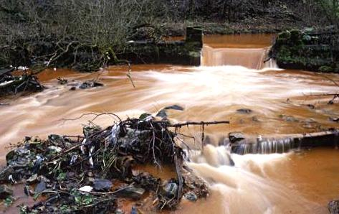
GIVE MORE EFFORT TO SAVE MOTHER EARTH
CONSERVE / SHIFT TO CLEAN ENERGY
REFORESTATION
DAVAO IS OUR HOME!
POLLUTION AWARENESS

Slide 33
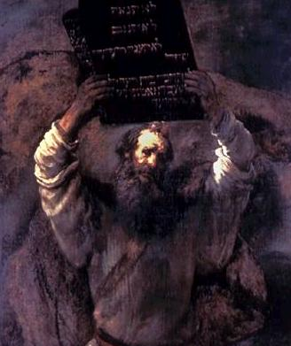
A MUST FOR ALL PROFESSIONALS
2
“THOU SHALL NOT STEAL”

Slide 34
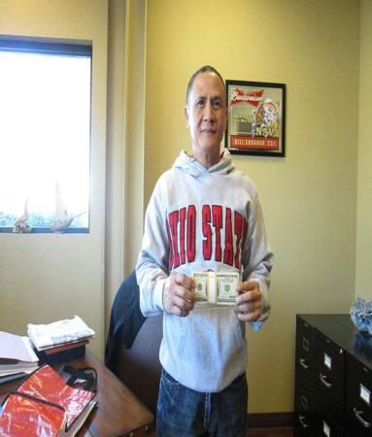
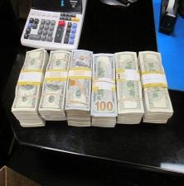
Filipino cab driver RETURNED $300,000 IN HARD CASH left behind by a passenger. He was rewarded handsomely and adored for his HONESTY.
GERARDO GAMBOA
“My dignity is not for sale, and that's the way I am. That's the way our parents taught us when I was a kid"

Slide 35
WE ARE STILL AN HONEST PEOPLE!
Journalists made an experiment
“LOST” 30 cell phones in each capital city
Went to the nearest police stations and waited for a call from the finder
By the number of cell phones RETURNED, they put together a list world’s top ten honest cities

Slide 36
TOP 5 MOST HONEST CITIES IN THE WORLD
1. Ljubljana, Slovenia (29/30)
2. Toronto, Canada (28/30)
3. Seoul, South Korea (27/30)
4. Stockholm, Sweden (26/30);
5. Mumbai, India; New York, USA and Manila, Philippines (24/30)

Slide 37
YOUR MOST IMPORTANT OBLIGATION AS GRADUATES AND PILLARS OF YOUR FAMILIES?

Slide 38
An old woman was sitting on a bench of a garden with her 25year old son. There was a tree beside the bench and the old woman saw a bird sitting on the tree-
“What’s is that bird my Son?”
“It’s a crow”

Slide 39
“What’s is that bird my Son?”
“I already told you that it’s a crow”

Slide 40
“What is that bird my Son?”
”Are you deaf or mad, Nanay? How many times to tell you it’s a crow. Can’t you understand?”

Slide 41
“My dearest Son, when you were 5yrs old, you asked me the same question - what’s that bird Nanay?- 174 times and each time I replied with a kiss that, it’s a crow! Now, I asked you 3 times and you are already irritated…”

Slide 42

The FIRST to help you
FINISH YOUR RACE

Slide 43
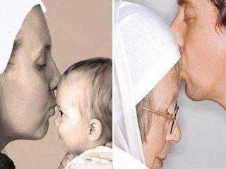
3
Honor and serve your parents when they will be dependent on you. NEVER HURT THEM!
You will be in their shoes soon!

Slide 44
IN A NUTSHELL:
WORK AND SERVE YOUR COUNTRY WITH DUE HONESTY
LOVE AND RESPECT YOUR PARENTS…
DO IT AND YOU WILL LIVE LONG!

Slide 45
SINGING IS TWICE PRAYING…
Magsimula ka pilitin ng tuklasin ang hanap
Magdanas man ng maraming hirap
Ang mithiin mo pag naging ganap
Langit ang pagsisikap iyo nang malalasap

Slide 46
Iisa ang buhay mo kumilos ka gamitin mo
Kung may nais ang puso mo mangarap ka abutin mo
Upang ito’y makamit mo magsikap ka
SIMULAN MO!

Slide 47
CLASS 2018, I TAKE PRIDE IN SPEAKING TO YOU
REACH OUT FOR YOUR DREAMS!
CONGRATULATIONS & GOD BLESS!

