Slide 1
The eco group journey

Slide 2
ECOTRANS CAR RENTALS

Slide 3
R&S CARGO CORP.
ECOHAULERS, INC.
ECOFREIGHT LOGISTICS, INC.

Slide 4
THINGS I LEARNED IN BUSINESS

Slide 5
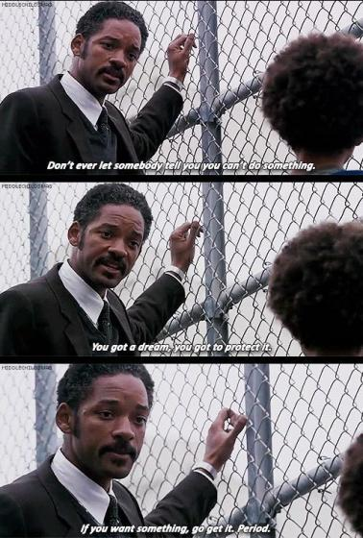
1. Don't let anyone tell you what you can or cannot do
The Pursuit of Happyness (2006)

Slide 6
2. Don't be afraid to fail

Slide 7
3. Dig your well before you're thirsty

Slide 8
4. Do what you love

Slide 9
5. Target a niche market

Slide 10
6. Always have a competitive advantage / Know when to quit

Slide 11
7. Give more than you promise

Slide 12
8. Diversify

Slide 13
9. Give back

Slide 14
10. Be proud of your country

